Slide 1
Business and Industrial Economics
Prof. Luca Grilli
Price discrimination: Part 3 (bundling)

Slide 2
Another important type of price discrimination by self-selection (2° PD):
BUNDLING

Slide 3
Bundling
Def. Bundling is a offering of two or more distinct but related products as a package at a single price.
Pure bundling : sale of the package but not of single components. Example: Netflix
Mixed bundling: sale of the package and of single components (package price < sum of prices of single components).
(Mixed bundling) Type of a 2° price discrimination/versioning (example Microsoft office).
Pure bundling logic ≈ Mixed bundling logic
We primarily focus on the pure mode to make general points

Slide 4
Profitable bundling = Reduce ‘willingness to pay’ dispersion

Slide 5
When “to bundle” is especially profitable?
Heterogeneous and negatively correlated willingness to pay of consumers for single components (someone has to prefer more one component, someone else more another one) but overall, the sum of the willingness to pay of consumers for the products should be rather similar.
The sum of the dispersions of the willingness to pay single components has to be greater than dispersion of the willingness to pay the bundle.

Slide 6
Bundling always profitable?
Useless Bundling
Useless Bundling
bundling: Π = 260
No bundling: Π = 260
Harmful (or useless) Bundling
bundling: Π = 140 (or 220 if target only Marco)
No bundling: Π = 220

Slide 7
Bundling always profitable?
Profitable Bundling
Harmful Bundling
bundling: Π = 80*2= 160 (or 220 if target only Marco)
No bundling: Π = 240 (p_{s} = 60; p_{w} = 120)
N.B. When a small group of potential consumers shows relatively a very low willingness to pay for the bundle try to target these consumers and sell them the bundle may not be convenient (there is “insufficient wtp” looking at the participation constraint).

Slide 8
PROPOSITIONS

Slide 9
1. Killer applications
Best Profits with complete bundling (640$: p_{bundling} = 160$ for 5 games, bundling sold at first 4 consumers).
Best profits with partial bundling (710$: p_{bundling} = 90$ for first 4 games, p_{game5} = 70$).
1° Proposition: Better not to bundle “superstars”

Slide 10
2. Mixed vs. Pure Bundling
Consumers/Software | Word | Excel
A | 40 | 20
B | 20 | 40
C | 45 | 5
D | 5 | 45
No bundling: Profits = 160; p_{word} = p_{excel} = 40$.
Pure bundling: Profits = 200; p_{bundling} = 50$.
Mixed bundling: Profits = 210; p_{bundling} = 60$; p_{word} = p_{excel} = 45$.
2° Proposition: Mixed bundling more complex to implement but it may lead to greater profits than the pure one (note that the maximizing p_{bundling} is different in pure bundling vs. mixed bundling and higher for the latter).

Slide 11
3. Auction
Types: Ascending (aka English), Descending (Dutch), First-price sealed-bid, Second-price sealed-bid.
Why do AUCTIONs are often preferred to sale at fixed prices (even if they entail a cost, in setting up, managing, etc.)?
Focus: Ascending. Suppose a (risk-neutral) seller has to sell an item. There are only 2 potential buyers. Buyers’ evaluations for the item are either both 100$ or both 150$. Buyers of course know their evaluations, while the seller doesn’t. The seller only knows that each value is equally likely.
Scenario “Fixed price”: if the seller sets a price of 100$ he is certain to sell the item (gaining 100$). If he sets a price of 150$ he has 50% probabilities to get 150$, and 50% to end up with 0$. This results in an expected value of 75$, which is lower than 100$. Thus, in this scenario, he will opt for setting p=100$.
Scenario “English auction”: He starts the auction by calling out 100$. If buyers value the item 100$ they will make a sign of acceptance. As the seller asks for higher bids, buyers will be silent and the auction ends with a winning bid of 100$ (let’s suppose that the quicker buyer wins). This occurs with probability of 50%. However, if buyers’ valuation is 150$, they will continue outbidding each other, until the price reaches 150$. This event will occur with probability of 50%. So the expected value, in this scenario is 125$ > p=100$.
3° proposition: When seller has only a vague idea on buyers’ potential valuations, auction is a mechanism to make buyers pay a price that reflect their valuations. This makes it similar to 2° Price discrimination.

Slide 12
References
Cabral Industrial Organization I edition, 2000: chapter 10 [or Industrial Organization II edition, 2018: chapter 6.1-6.3].
Varian, Intermediate Microeconomics, chap. 26.7.
Further reading:
Cabral Industrial Organization I edition, 2000: chapter 6.3, 6.4 [or Industrial Organization II edition, 2018: chapter 4.2, 4.3].
Varian, Intermediate Microeconomics, chap. “Monopoly Behavior”, 26.1, 26.2, 26.3, 26.4, 26.5, 26.6)
Shapiro & Varian, Information Rules, chapter 3.

Slide 13
Business and Industrial Economics
Prof. Luca Grilli
Exercises on Monopoly &
Price Discrimination
[from Cabral (2018) and my own]

Slide 14
1.

Slide 15
Solution

Slide 16
2a.
2b.
In the Apps marketplace, the freemium business model is very popular. Is this price discrimination? Of what type?
2c.
Music, movies, or videogames Internet platforms, besides the freemium business model, also often sell their premium version with a fixed subscription fee for which all content is available. How could you define such strategy?

Slide 17
Solution
2a.
2b.
Answer: This is a form of 2° PD: versioning. Beginners/Basic (i.e. relatively not-very-interested) consumers self-select themselves for the “free” version [with advertising, with the double advantage for the company that it gets revenues from advertisers and has an additional important dimension (i.e. the nuisance of advertising for consumers) to differentiate the versions] and the Experts/Sophisticated (relatively more interested) consumers choose the “premium” version (paying a positive price, accessing content without advertising and potentially with additional features). One disadvantage in practice is that if a large portion of Experts/Sophisticated consumers find the “free” version good enough, and advertising does not bring you enough revenues, the business model may turn out to be unprofitable.
2c.
Answer: Pure bundling.

Slide 19
Solution
(Or 3° PD)

Slide 20
4. Exam question February 2020

Slide 21
Solution
Just apply the Lerner index formula
Europe: (p – 150)/p = 1/4
P = 200
Asia: (p – 150)/p = 2/3
P = 450

Slide 22
5. Exam question February 2022

Slide 23
Solution

Slide 24
6. Exam question February 2018

Slide 25
Solution
a) It does not respect the incentive-compatibility constraint. Expert users will self-select themselves for the basic version. Thus profit in this case is equal to 4000.
b) The incentive-compatibility constraint is respected. Thus profit in this case is equal to 5600
c) The advanced/basic version will be sold only to experts, reaching in the best scenario a profit of 4400.
d) Profit in this case is equal to 7000. The highest.
The correct answer is d).

Slide 26
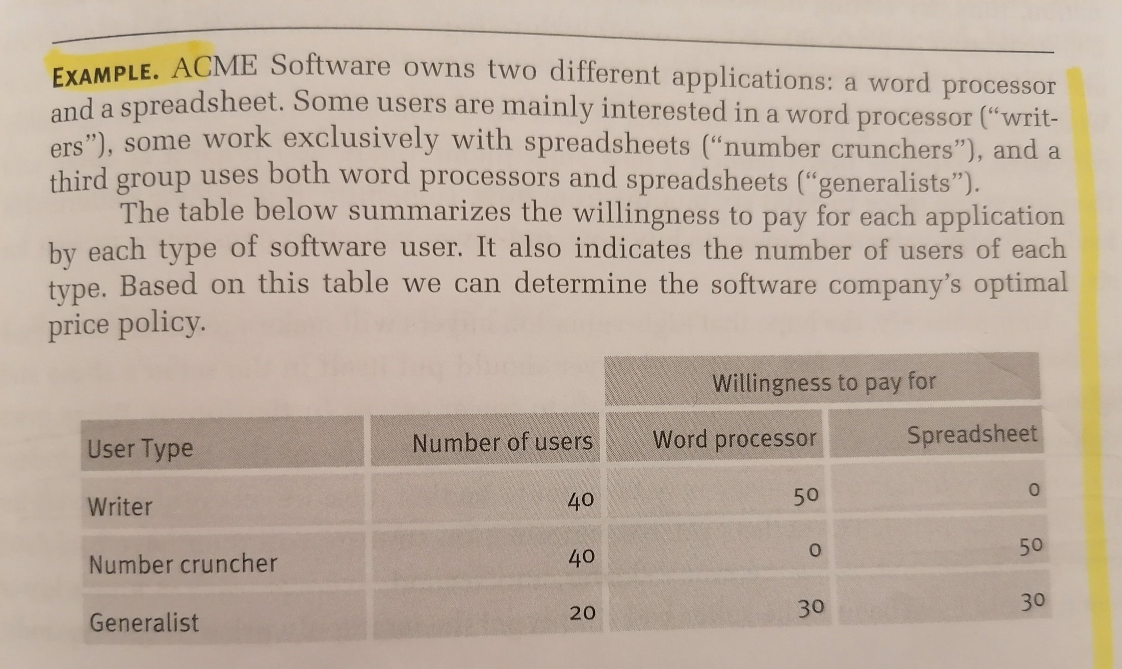
7. Optimal bundling policy

Slide 27
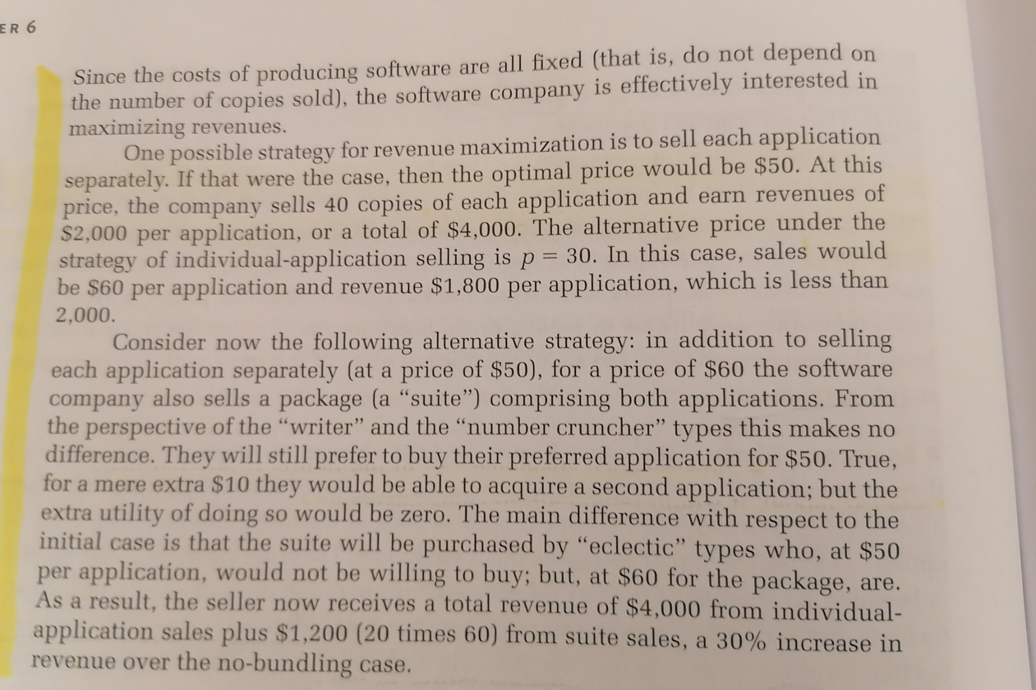
Solution

Slide 28
8. Exam question January 2023
If two buyers have different relative valuations for two goods and these relative valuations are negatively correlated, considering the total revenue (TR), then:
TR will be greater with individual pricing of the two goods than with bundling.
TR will be greater with bundling than with individual pricing of the two goods.
TR will be identical with individual pricing of the two goods and with bundling.
It is impossible to tell what will happen to TR without more information.

Slide 29
Solution
If two buyers have different relative valuations for two goods and these relative valuations are negatively correlated, considering the total revenue (TR), then:
TR will be greater with individual pricing of the two goods than with bundling.
TR will be greater with bundling than with individual pricing of the two goods.
TR will be identical with individual pricing of the two goods and with bundling.
It is impossible to tell what will happen to TR without more information. BONUS

Slide 30
9. Exam question February 2022
Which of the following statements about the comparison between monopolistic competition in the long run and monopoly in the long run is false?
a) Marginal revenue is less than price for both monopoly and monopolistic competition.
b) Price is greater than marginal cost for both monopoly and monopolistic competition.
c) Price is greater than average cost for both monopoly and monopolistic competition.
d) Neither monopoly or monopolistic competition produce at the minimum point of the average cost curve.

Slide 31
Solution*
Which of the following statements about the comparison between monopolistic competition in the long run and monopoly in the long run is false?
a) Marginal revenue is less than price for both monopoly and monopolistic competition.
b) Price is greater than marginal cost for both monopoly and monopolistic competition.
c) Price is greater than average cost for both monopoly and monopolistic competition. BONUS
d) Neither monopoly or monopolistic competition produce at the minimum point of the average cost curve.
*Note that a) and b) are without any doubt correct statements, while c) is without any doubt false for what concerns monopolistic competition (remember slide no. 7 of Lecture 3 “Firm heterogeneity, market power and price discrimination”), where we know that in the long run equilibrium price is given by the tangency of the demand curve with the AC curve (P = AC). As to d) the monopolist can still produce at the MES only in the very specific case that its MR curve intersects the MC curve in correspondence of the minimum point of the AC curve. But, in general, statement d) is again true (or much less false than c)).

Slide 32
10. (part of) Structured question Exam September 9th 2020
[…..]the public authority wants to better understand the demand curve faced by the monopolist and its costs structure, in order to consider the possibility to ex-ante regulate its price.
The appointed consultancy company estimates that the demand curve is equal to p = 45 – 10q and the total cost function of the firm is given by: TC = q² + 9q + 9.
4a) Is this a natural monopoly? Explain why yes or no.
4b) Which is the best price from a social welfare point of view?

Slide 33
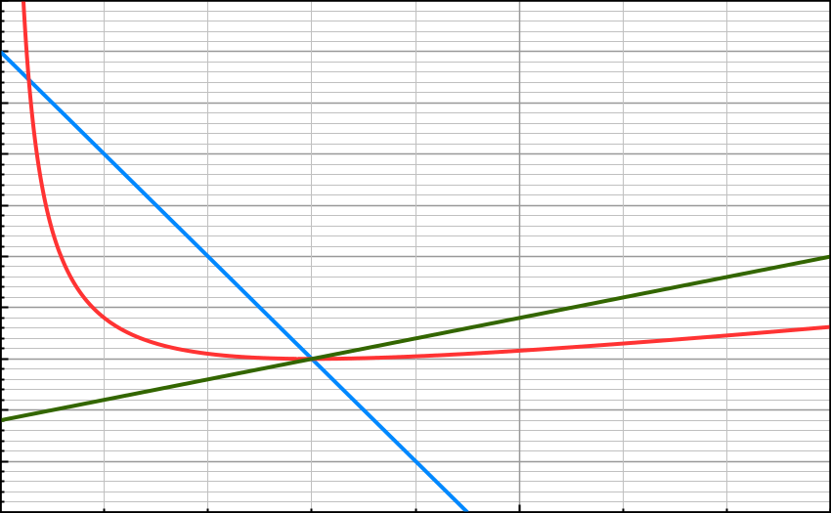
Solution
4a) Yes it is a natural monopoly since AC = q + 9 + (9/q) with a MES = 3. Demand curve p = 45 -10q intersects AC in correspondence of MES = 3.* So this is a natural monopoly given that the property of subadditivity of the total cost function is verified. Below the precise graphical representation of the relevant dimensions [inverse demand curve in blue, marginal cost curve in green and the average cost curve in red].
4b) The best price from a social welfare point of view is the one in correspondence of Min AC = MC and so p = 15.
* Hint: It is worth reminding the solution formula for a quadratic equation: q = [-b +/- (b² – 4ac)^{0,5}]/2a.

Slide 34
References
Cabral Industrial Organization II edition, 2018: chapter 6.1-6.3.

